Slide 1

Object Detection: Seeing the World Through Algorithms
Object detection identifies objects within images and videos. It powers innovations like self-driving cars, security systems, and medical diagnostics. This technology has evolved dramatically from basic rules to advanced deep learning models.

Slide 2

The Fundamentals: What is Object Detection?
Object Detection Defined
Versus Classification & Segmentation
Core Components
Locating and identifying objects in images with bounding boxes.
Bounding boxes
Detects object position, unlike classification or pixel-level segmentation.
Confidence scores
Class labels

Slide 3
Traditional Approaches: Feature Extraction and Machine Learning
Feature Extraction
Machine Learning Classifiers
Limitations
Haar features
SVM
Hand-crafted features limit adaptability and speed, with accuracy issues.
SIFT descriptors
AdaBoost
HOG gradients
Random Forests

Slide 4
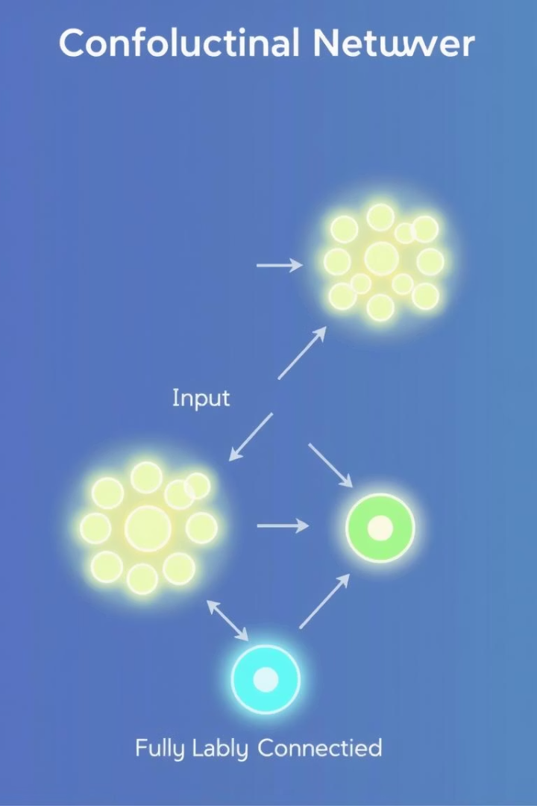
Deep Learning Revolution: Convolutional Neural Networks (CNNs)
CNN Architecture
Hierarchical Feature Learning
Layers learn spatial features automatically from raw images.
Low to high level abstractions improve detection quality significantly.
Benefits
Automatic feature extraction, higher accuracy, and faster processing.

Slide 5
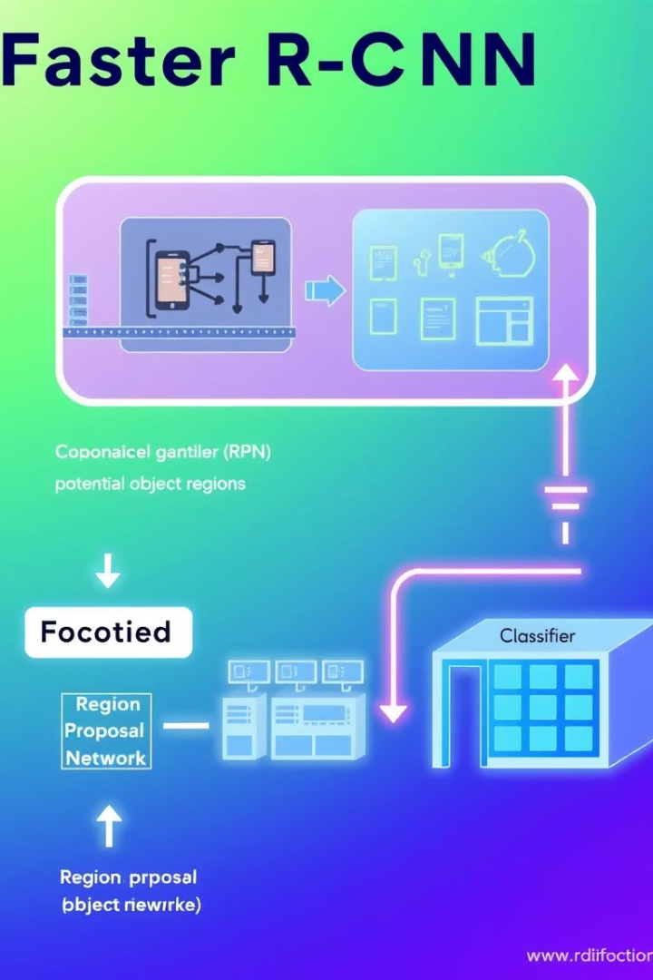
Two-Stage Detectors: Region-Based CNNs (R-CNNs)
R-CNN Family
Includes R-CNN, Fast R-CNN, and Faster R-CNN models.
Region Proposal Networks
Generate candidate regions for object detection.
Pros & Cons
High accuracy but slower inference speeds.
Example
Faster R-CNN achieves 73.2% mAP on COCO dataset.

Slide 6
One-Stage Detectors: YOLO and SSD
YOLO
SSD
Trade-offs
Detects objects in a single forward pass for real-time speed.
Uses multi-scale feature maps for better detection at various sizes.
Faster but slightly lower accuracy than two-stage methods.

Slide 7

Evaluation Metrics: Measuring Object Detection Performance
Intersection over Union (IoU)
Mean Average Precision (mAP)
Measures overlap between predicted and true bounding boxes.
Key summary metric of detection accuracy across classes.
Performance Factors
Object size
Partial occlusion
Viewpoint variation

Slide 8
Datasets for Object Detection: Training and Benchmarking
Popular Datasets
Dataset Features
Data Augmentation
COCO
Vary in images, categories, and detailed annotations.
Crucial for training robust, generalizable models.
Pascal VOC
ImageNet

Slide 9
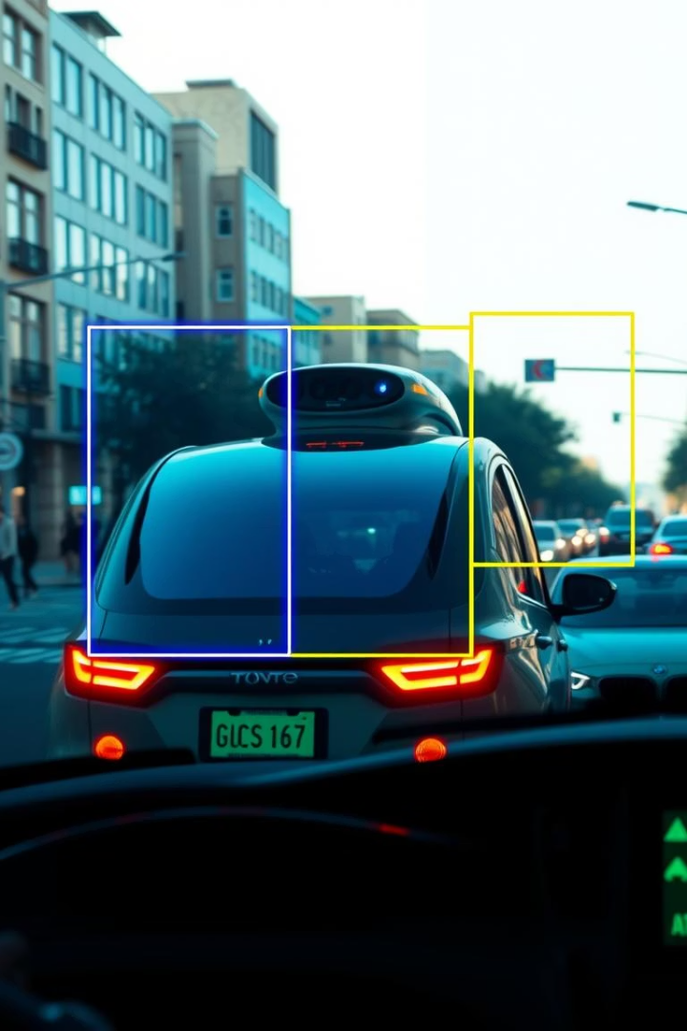




Applications in Action: Real-World Examples
Autonomous Driving
Surveillance
Medical Imaging
Identifies suspicious objects and activities in real time.
Detects vehicles and pedestrians for safe navigation.
Finds anomalies like tumors for early diagnosis.
Retail Analytics
Tracks customer behavior and manages inventory efficiently.

Slide 10

Future Trends: Advancements and Challenges
Transformer-Based Models
Innovative DETR and Swin Transformers improve detection.
Few-Shot Learning
Detect with limited labeled examples boosting flexibility.
3D Detection
Integrates depth info for richer scene understanding.
Ongoing Challenges
Robustness, small object detection, and computational costs remain.

